Slide 1
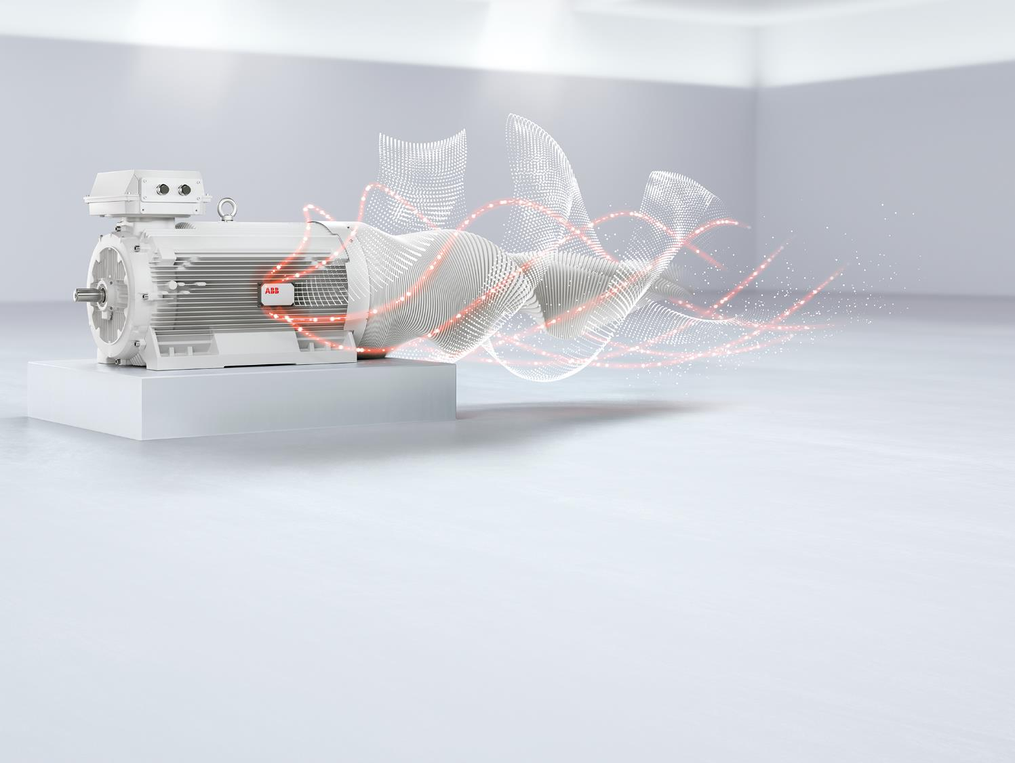
Bluetooth Panel and Drivetune App

Slide 2
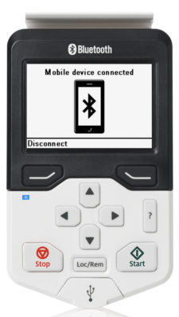
ACS-AP-W
Assistant control panel with Bluetooth interface
Standard on all US built ACS880 drives starting January 3rd
Orderable as a loose kit 3AXD50000025965
ACS880 can be ordered with standard panel ACS-AP-I (non-Bluetooth) with plus code +J425
Compatible with ACS880 firmware version 2.3 or later
Carton labeled with Bluetooth icon
Bluetooth icon
Tri-color LED(RGB)
Bluetooth dual mode radio and antenna embedded
Notes:
ACS-AP-W assistant control panel with Bluetooth interface is the new all-inclusive control panel for the ACS880 drive.
It provides all the same functionality as ACS-AP-I but additionally embeds Bluetooth technology inside.
It is easy to recognize from the printed Bluetooth logo on front cover. It also a embeds a powerful processor and more memory (100% more RAM and 33% more FLASH compared to I variant)
The tri-color led (green, red and blue) is used to indicate different states of the drive and its communication.
The ACS-AP-W can be delivered also as a loose item kit. Then the control panel is delivered in the cardboard box with the Bluetooth icon printed on it.
The ACS-AP-W panel will be standard on January 3rd with all US build ACS880 drives. If anyone would like the non-Bluetooth panel it can be ordered with the drive +J425

Slide 3
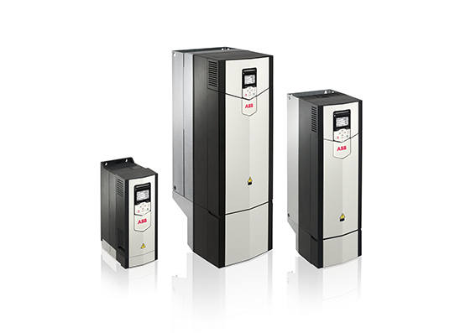
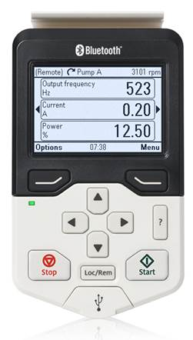
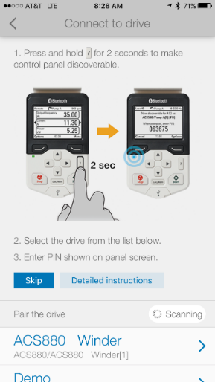
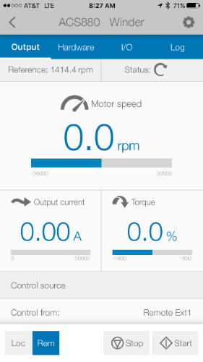
New Product Offering
Wireless communication with Drivetune
The Bluetooth Assistant control panel (ACS-AP-W) paired with a mobile device.
The Drivetune mobile application can be use with Android and iOS web-enabled mobile handsets. It can be used for commissioning, troubleshooting & maintenance tasks. Drivetune now has full parameter access!!
Available for free download on Google Play and the App Store
Drivetune Application
Notes:
The mobile app now has full parameter access and is downloadable for free on google play for android and the apple store. With the ACS-AP-W panel, you can connect your own device to the drive to configure and troubleshoot the drive via the Bluetooth connection. Easily find information from the app dashboard like how its being controlled for start stop and speed, what the DIs/Ais/RO/DO are programmed to do and their status, speed the drive is running at, as well as motor current and torque and the fault history. You can take control of the drive if you would like and start stop and control the speed right from the app. If you need more info or would like to comission the drive, the app does have full parameter access!

Slide 4
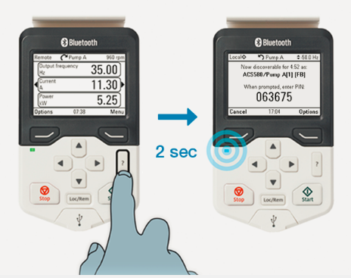
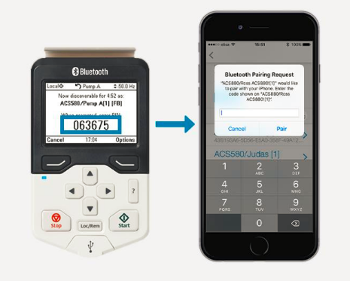
Pairing the ACS-AP-W
Press the ”?” button for 2 seconds to enable the Bluetooth radio (disabled by default)
There are two options available:
    A drive is discoverable via Bluetooth for five (5) minutes. An random generated PIN code is created when the mode is entered
    Optionally a drive can be set to be always discoverable (Bluetooth radio always on) and keeps the generated PIN code
  Device will not reconnect to earlier paired drives automatically
Notes:
There are two options available:
1. A drive is discoverable for certain period of time. The discoverable time is five minutes. This is default setting and an user can change the setting to always discoverable, whenever needed. This is a safer option from Cyber security point of view because the mode timeouts automatically. The drive generates an unique PIN code always when it is set to Bluetooth discoverable.
2. A drive is made ”Always discoverable” which is helpful in cases when a drive is hard to access due to high or narrow places. A user needs to first set the drive to discoverable and then enable the always discoverable option to make the drive always discoverable. The PIN code which is created when the drive is set fist time discoverable is kept the same and the drive remembers it always. It is stored also over the reflashing of the control panel. A new Pin code can be created by disabling the discoverable mode and resetting the drive again to discoverable.
As described earlier the pairing or bonding is a mechanism where a drive and e.g. smart phone with Drivetune both know how to connect securely to each other, accept the connection and and start communicating over Bluetooth. The PIN code is needed when pairing drive and phone. In contrast to more common Bluetooth devices, like head phones and car audio systems, the drive and phone must always be paired before they can communicate. The pairing is not either stored so the phone won’t reconnect to earlier paired drives automatically. The reason for this is the safety ensuring unintentional connections to happen.

Slide 5
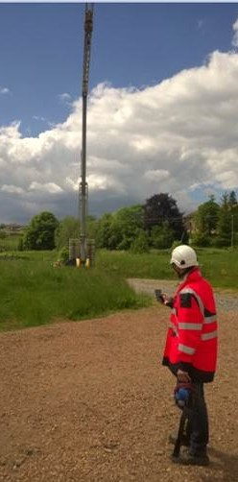
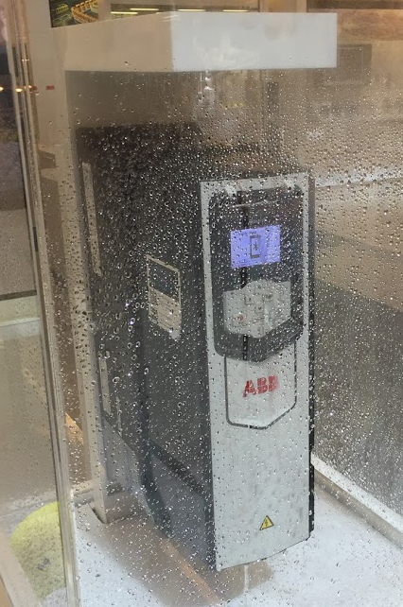



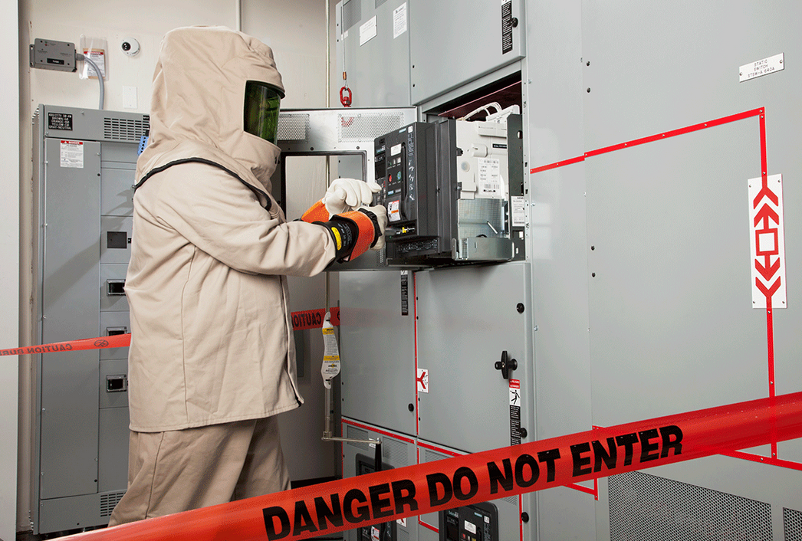

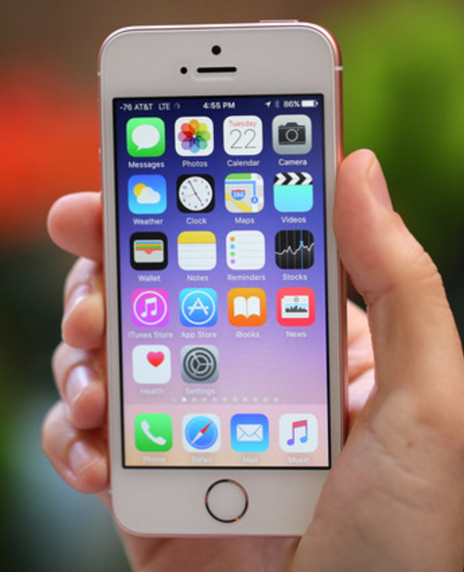

ACS-AP-W
Assistant control panel with Bluetooth interface
Extended range of access, e.g. a crane application where the Drives are 246 feet or 75 meters away.
Safety improvement, e.g. arc flash avoided.
Easier to access, e.g. dripping water situation, air handler where drives are difficult to access.
Use your own & favorite device -> Your smartphone
User Benefits
Notes:
You can access the drive with out a cord with the ACS-AP-W and the Drivetune app. Wont need to access difficult to reach work areas to access info on the drive. The drive will register with the Drivetune app within 75m (246 ft) of the smart phone or tablet. No need to enter hazardous areas to get at the drive. It gives you the power to bring your own device!

Slide 6
Frequently Asked Questions
Is the radio on be default?
No, it has to be enabled by pressing the “?” button for 2 seconds
Will my device auto connect?
No, but you can set the panel to always discoverable which will keep the same
PIN code
Can I set the PIN code myself?
At this time no, but this is being looked into as an enhancement
Can I lock the Bluetooth feature out?
Unfortunately at this time you cannot, but it is something that is being looked into as an enhancement. If this is a concern, the +J425 can be ordered to get the ACS-AP-I (non-Bluetooth) panel instead of the ACS-AP-W
Does the Drivetune App have full parameter access?
Yes, with the latest version for Apple and Android, there is full parameter access.

